Slide 1
British Airways
Key Insights

Slide 2
Data Overview
Dataset is Used for Customer feedback reviews related to British Airways from the Skytrax website. The dataset contains 1000 reviews.
Data Preprocessing:
Scraped and collected review data from the Skytrax website using Python and BeautifulSoup.
Removed irrelevant text like "✅ Trip Verified" from each review.
Performed data cleaning (converting to lowercase, stop-words removal, punctuation removal etc) to prepare the text data for analysis.

Slide 3
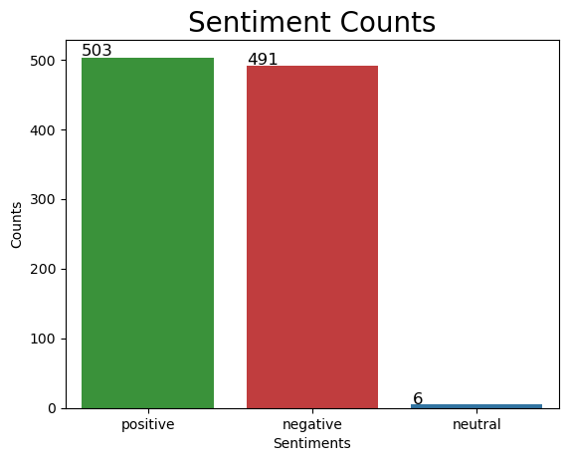
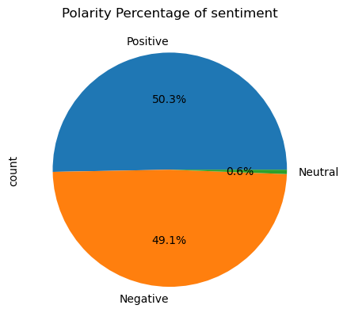
Sentiment Analysis
Sentiment Analysis Results:
Total Reviews: 1000
Positive Reviews: 503 (50.30%)
Negative Reviews: 491(49.10%)
Neutral Reviews: 6(0.60%)

Slide 4
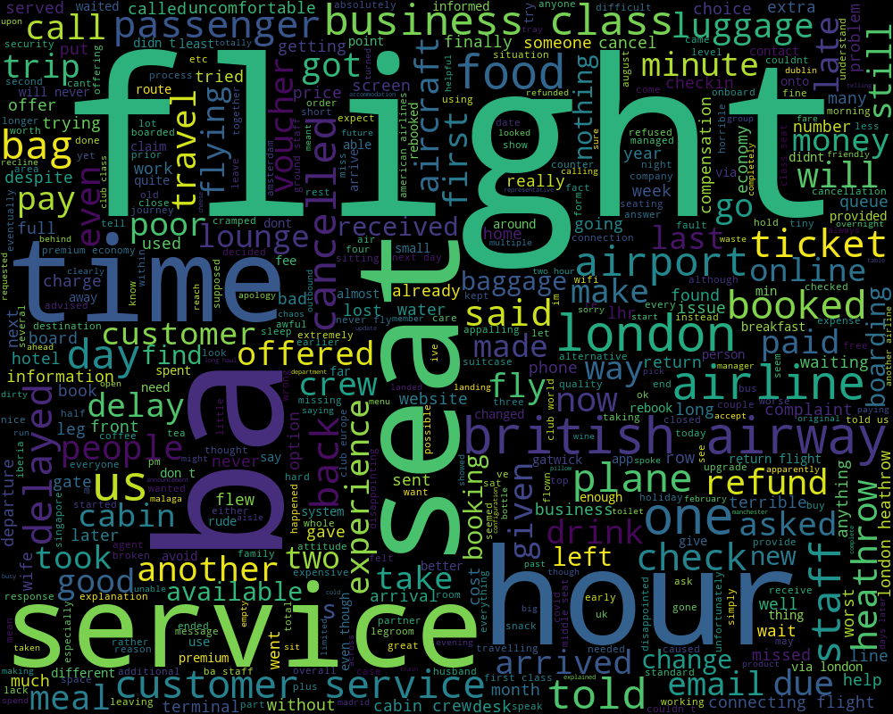
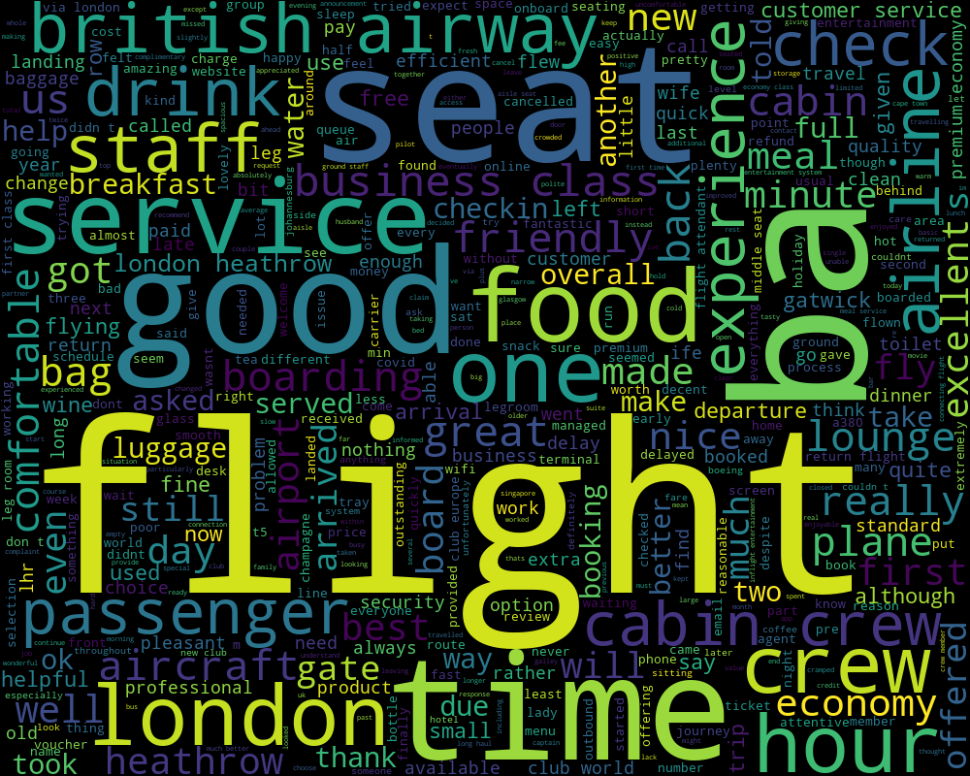
Most Frequent words
Negative Sentiments
Positive Sentiments

Slide 5
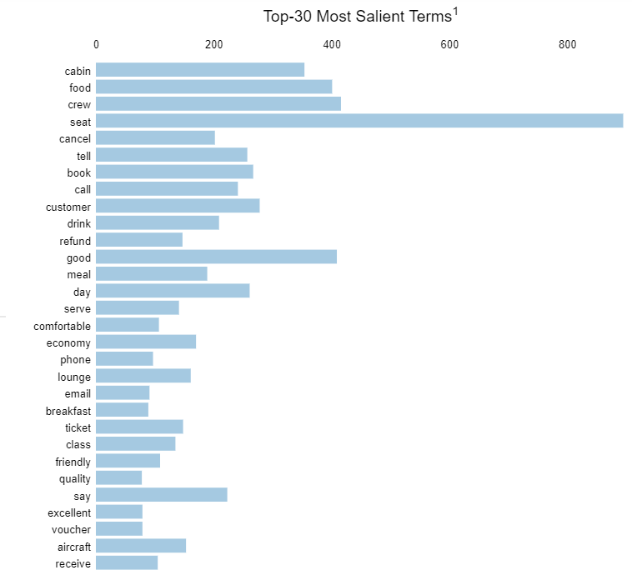
Topics in reviews
ML Model used: LDA using genism package, Coherence score:60%. File path
Results: 8 topics inferred
Flight Service
Flight Booking
Food
Food Quality
Emotion
Health
Communication
People

